Slide 1

What’s in a Name?
Hello, my name is …
Gabrielle Salamanca

Slide 2
1.
The Dataset
Rnames

Slide 3
Are Emily and Greg More Employable than Lakisha and Jamal?

Slide 4
About the Data
Vincent Arel-Bundock’s Github projects
R datasets
4870 rows x 23 columns
Applicants’ resumes
Job requirements
Type of job

Slide 5
The Origins
The National Bureau of Economic Research
Working Papers
Are Emily and Greg More Employable than Lakisha and Jamal? A Field Experiment on Labor Market Discrimination
Marianne Bertrand
Sendhil Mullainathan

Slide 6
The Experiment
Send 4,870 fictitious resumes to job adverts
Randomly assigned a name
Caucasian or African-American
Which ones got a call back

Slide 7
Was the name the main reason for not receiving a call back, or were there other factors affecting it?

Slide 8
Goal: Classification
Find a model that can provide the most accurate prediction
Response variable
Call back

Slide 9
Data Visualization

Slide 10
Resume Names
X | name | gender | ethnicity | quality | call | city | . . .
1 | Allison | female | cauc | low | no | chicago | . . .
2 | Kristen | female | cauc | high | no | chicago | . . .
3 | Lakisha | female | afam | low | no | chicago | . . .
4 | Latonya | female | afam | high | no | chicago | . . .
5 | Carrie | female | cauc | high | no | chicago | . . .
6 | Jay | male | cauc | low | no | chicago | . . .
. . . | . . . | . . . | . . . | . . . | . . . | . . . | . . .

Slide 11
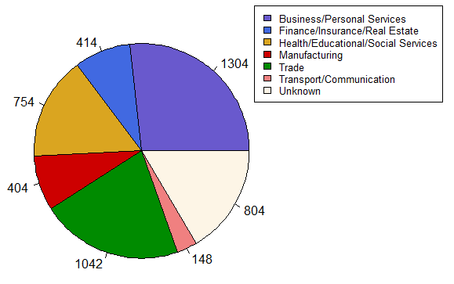
What industries were the jobs offered in?

Slide 12
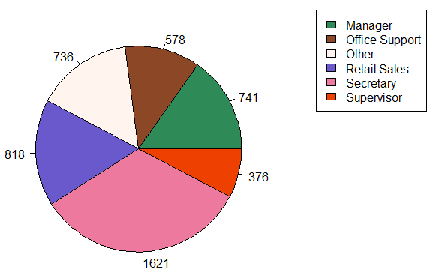
What were the offered positions?

Slide 13
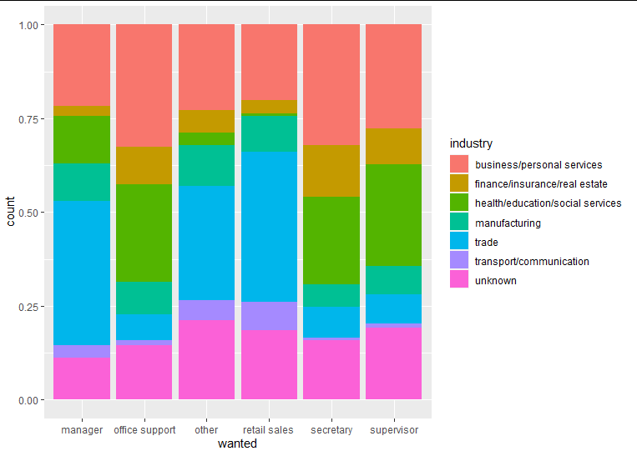
Positions in terms of Industry

Slide 14
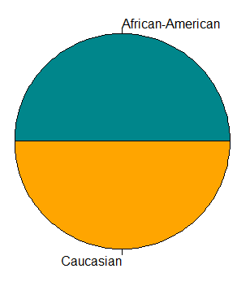
Ethnicity: Caucasian vs African-American
4,780 applicants
2,435 Caucasian
2,435 African-American

Slide 15
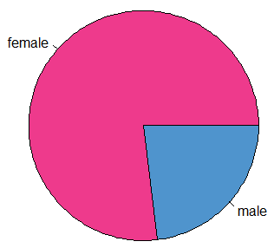
Gender: ♀ vs ♂
4,870 applicants
3,746 female
1,124 male

Slide 16
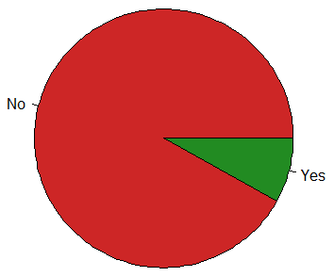
Call back: Yes vs No
4,870 applicants
4478 ‘no’s
392 ‘yes’s
>

Slide 17
2.
Cleaning and Reorganizing
Rnames → Names

Slide 18
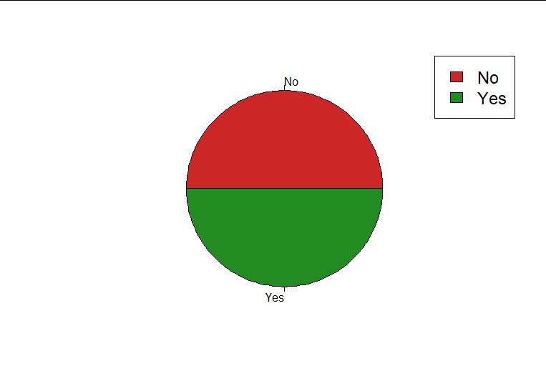
Downsampling
Most important variable
Call back
Before vs After
4,478 vs 392
392 vs 392
=

Slide 19
Updating Dataset
Newnames
downSample(Rnames, Rnames$call)
Names
Removing variables
subset()
X
Cell number
Name
Descriptor of Ethnicity
City
Boston vs Chicago
Class
Added by downSample()
Classifying each case

Slide 20
Industry - Wanted Removal?
Originally excluded due to “missing values”
unknown/other
During further testing
Inclusion of Industry - Wanted
Accuracy boosted (in some cases)

Slide 21
3.
Methods
What have I tried?

Slide 22
GLM Fitting
Splitting the Data
80% training
20% test
summary()
Finding the most significant variables
Use a variation of those variables to find the best fit

Slide 23
Without Industry-Wanted Vars
Accuracy
55% < y < 65%
Best fit
63.69427%
glm.fit1
Variables
Ethnicity
Experience
Special
Reqeduc

Slide 24
With Industry-Wanted Vars
Accuracy
50% < y < 65%
Best fit
63.69427%
glm.fit5
glm.fit7
Variables
Ethnicity (5, 7)
Experience (5, 7)
Special (5, 7)
Reqeduc (5, 7)
Honors (5, 7)
Reqcomp (5, 7)
Requirements (7)
Industry (5, 7)

Slide 25
The Methods
Best Subset Selection
Cross-Validation
LDA
QDA
KNN
Ridge Regression
LASSO

Slide 26
The Fits Being Used
glm.fit1
No Industry var
58.59873%
glm.fit5
Industry var
62.42038%
 | No | Yes
No | 48 | 30
Yes | 35 | 44
 | No | Yes
No | 54 | 31
Yes | 28 | 44

Slide 27
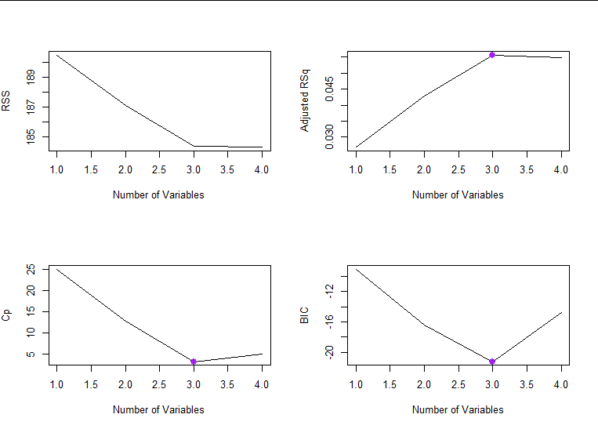
Best Subset Selection: No Industry
When n > 3, RSS is small

Slide 28


Cross-Validation: No Industry
N = 3
Adjusted
BIC

Slide 29
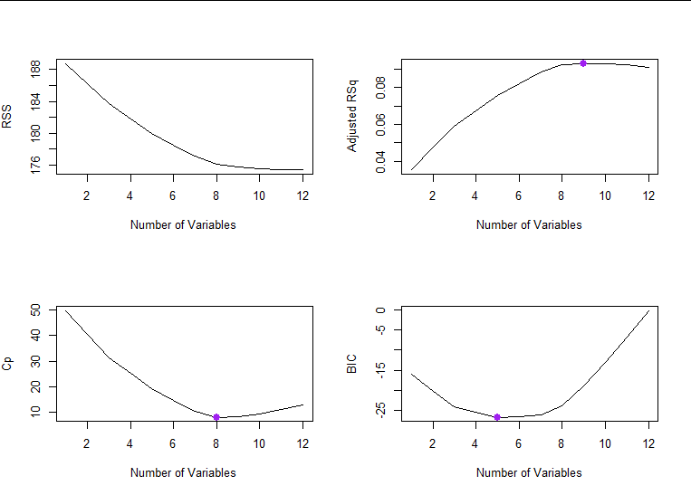
Best Subset Selection: Industry
When n > 10, RSS is small

Slide 30
Cross-Validation: Industry
Adjusted
N = 9
BIC
N = 5
N = 8

Slide 31
Classification Methods: No Industry
LDA
58.59873%
QDA
54.77707%
KNN
K = 1
60.50955%
K = 5
64.96815%
 | LDA
 | No | Yes
No | 48 | 30
Yes | 35 | 44
 | QDA
 | No | Yes
No | 51 | 39
Yes | 32 | 35
 | KNN
K = 1 | No | Yes
No | 55 | 34
Yes | 28 | 40
 | KNN
K = 5 | No | Yes
No | 54 | 26
Yes | 29 | 48

Slide 32
Classification Methods: Industry
LDA
62.42038%
QDA
61.78344%
KNN
K = 1
60.50955%
K = 5
64.33121%
 | LDA
 | No | Yes
No | 54 | 31
Yes | 28 | 44
 | QDA
 | No | Yes
No | 60 | 38
Yes | 22 | 37
 | KNN
K = 1 | No | Yes
No | 53 | 33
Yes | 29 | 42
 | KNN
K = 5 | No | Yes
No | 52 | 26
Yes | 30 | 49

Slide 33
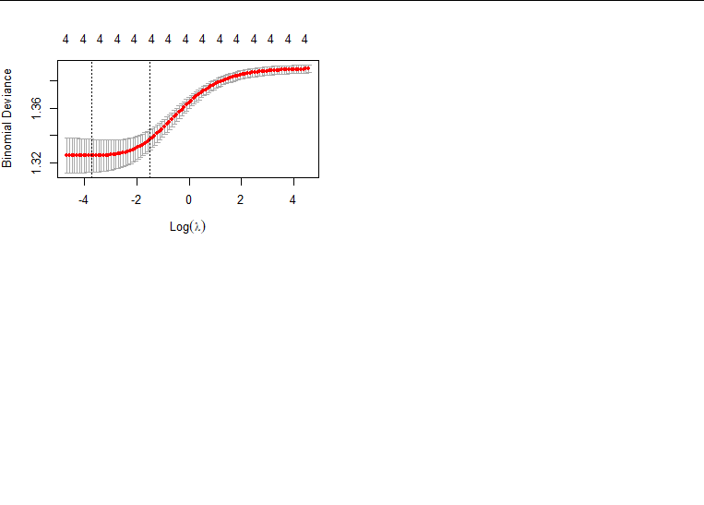
Ridge Regression: No Industry
Accuracy
59.87261%
 | No | Yes
No | 51 | 31
Yes | 32 | 43

Slide 34
Ridge Regression: No Industry
Ridge | Coefficients
Intercept | — 0.8972270
Ethnicity (cauc) | 0.4511977
Experience | 0.0492280
Special (yes) | 0.6192874
Reqeduc (yes) | — 0.1183023

Slide 35
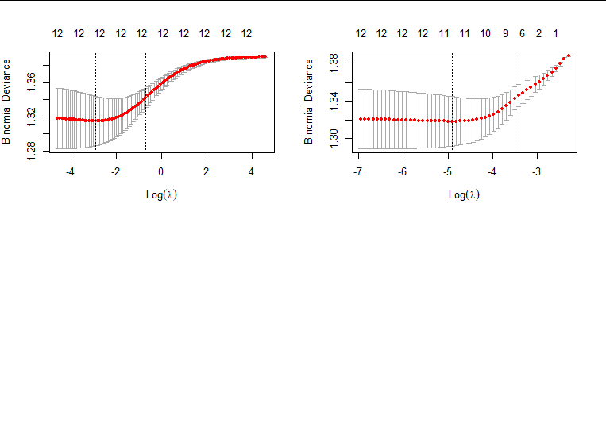
Ridge Regression: Industry
Accuracy
63.69427%
 | No | Yes
No | 55 | 30
Yes | 27 | 45

Slide 36
Ridge Regression: Industry
Ridge | Coefficients
Intercept | — 0.46743944
Ethnicity (cauc) | 0.30914913
Experience | 0.03065452
Special (yes) | 0.56394817
Reqeduc (yes) | — 0.53606360
Honors (yes) | 0.58931603
Ridge | Coefficients
Reqcomp (yes) | — 0.35486429
Industry Finance Insurance Real Estate | — 0.24239488
Industry Health Education Social Services | 0.33985341

Slide 37
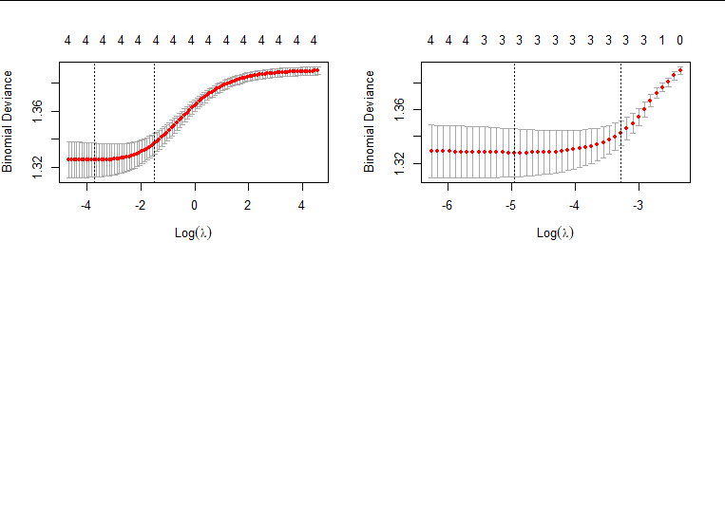
LASSO: No Industry
 | No | Yes
No | 51 | 31
Yes | 32 | 43
Accuracy
59.87261%

Slide 38
LASSO: No Industry
Ridge | Coefficients
Intercept | — 0.84673040
Ethnicity (cauc) | 0.40982207
Experience | 0.04588278
Special (yes) | 0.59580626
Reqeduc (yes) | 0

Slide 39
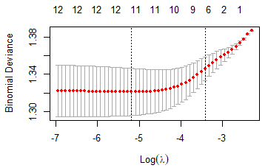
LASSO: Industry
 | No | Yes
No | 55 | 29
Yes | 27 | 46
Accuracy
64.33121%

Slide 40
LASSO: Industry
LASSO | Coefficients
Intercept | — 0.59813958
Ethnicity (cauc) | 0.34333831
Experience | 0.03385181
Special (yes) | 0.69530054
Reqeduc (yes) | — 0.60125455
Honors (yes) | 0.62044904
LASSO | Coefficients
Reqcomp (yes) | — 0.40395699
Industry Finance Insurance Real Estate | — 0.12613050
Industry Health Education Social Services | 0.39792262

Slide 41
Best Classification Accuracy
Without Industry
KNN, K = 5
64.33121%
Same percentage
Industry not as important as expected
64.33121%
KNN, K = 5
LASSO
With Industry

Slide 42
The Rankings: No Industry
KNN, K = 5
64.96815%
KNN, K = 1
60.50955%
Ridge Regression
59.87261%
LASSO
59.87261%
LDA
58.59873%
QDA
54.77707%

Slide 43
The Rankings: Industry
KNN, K = 5
64.33121%
LASSO
64.33121%
Ridge Regression
63.69427%
LDA
62.42038%
QDA
61.78344%
KNN, K = 1
60.50955%

Slide 44
Conclusion
Best Accuracy Rate
KNN, K = 5
With or without industry
Best RSS
With Industry
Improvements?
Minimum variable
Problems in code
Too many lvls
Further explore Best Subset
Find best fits with the limitations

Slide 45
Credits
Special thanks to all the people who made and released these resources for free:
Presentation template by SlidesCarnival
Photographs by Unsplash
Bertrand, M. and Mullainathan, S. (2003). Are Emily and Greg More
Employable than Lakisha and Jamal? A Field Experiment on Labor
Market Discrimination (Working Paper No. 9873). National Bureau of
Economic Research. http://www.nber.org/papers/w9873

